Slide 1
Throubmophelibitis of Jugular vein in horses
KAMAL M. ALSAAD

Slide 2
Thrombophlebitis is a venous thrombosis secondary to vessel wall inflammation, it most commonly affects jugular veins (or peri-venous injection)in horses because these vessels are the most accessed.
Jugular thrombophlebitis is one of the most common vascular diseases in horses. It is usually iatrogenic, associated with inadequate venipuncture technique, intravenous injections of irritant drugs .
Improper placement and/or management of indwelling catheters . Its occurrence is even greater if there is predisposition of the patient, especially in cases of intestinal diseases(mostly colic) laminitis and endotoxemia

Slide 3
Medicines that are most frequently associated with thrombophlebitis development are glycerol guaiacolate, thiopental, calcium gluconate, oxytetracycline, and phenylbutazone, a widely used antiinflammatory in athletic horses.
Complications of jugular vein thrombophlebitis in horses, its either septic or not, are decreased blood performance and could lead to death.

Slide 4
Clinical signs …
Intermittent fever,
Depression,
Neck stiffness.
Palpation elicits local swelling, heat, pain, and a cord-like jugular vein. Or swelling around jugular vein
Redness.
Swelling.
Tenderness.

Slide 5
Complete thrombosis is usually obvious and leads to visible distension of the proximal part of the jugular vein and the superficial vessels of the head.
Head edema may develop during exercise and during grazing, particularly when both jugular veins are thrombosed.
Septic jugular thrombophlebitis often leads to painful, warm swellings of the jugular groove and may be associated with fever, depression, inappetence, leukocytosis, and hyperfibrinogenaemia.
•Septic thrombophlebitis and/or periphlebitis may result in abscess formation.

Slide 6
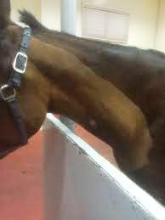

Slide 7
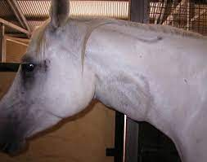

Slide 8
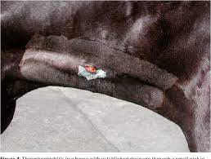

Slide 9
Pathophysiology
It may involve complete stasis of venous and arterial blood flow in the lower extremity because venous return is occluded or massive edema cuts off arterial blood flow. Venous gangrene may result. Infection could develops in venous clots.
Due to the fact that mature thrombus composed of platelets, leukocytes and fibrin develops, and an active thrombotic and inflammatory process occurs at the inner surface of the vein, with an active inflammatory response occurring in the wall of the vein
The jugular vein is an important body part because it drains deoxygenated blood from the head and the neck, block the jugular veins, My leads to increase brain pressure.

Slide 10
Diagnosis …
History and clnical signs
Contrast radiography
Ultrasonography …Ultrasonography is a sensitive tool to detect subclinical thrombosis. It can be used to assess the size of the thrombus and the degree of jugular vein obstruction, and to demonstrate thickening of the vessel wall, perivenous oedema, or abscess formation. Cavitation of the thrombus suggests a septic process.

Slide 11
Treatment & management ….
1-anti-thrombotic agents such as Heparine 150 I.U /kg Bw. S.C for 10 days
2- or heparine 150 I.U/kg Bw S.c followed by by 125 I.U/kg Bw S.c for 6 doses (twice daily) followed 100I.U/kg Bs S.c for 3-4 doses
Note: heparine injection could cause hot swelling and pain
3-Hot compresses may be applied every 4 to 6 hours in the acute phase
4-Non-steroidal anti-inflammatory injectable drugs,

Slide 12
5- systemic antibiotic such as penicilline streptomycin injection
6-In horses with bilateral jugular thrombosis, the head should be tied up to reduce head oedema and upper airway obstruction.
7-Surgical resection (Thrombectomy with a Fogarty catheter)of the affected vein and drainage of adjacent abscesses may be indicated in severe cases.
8-Autotransplantation of the saphenous vein may be considered after complete resolution of the infection

Slide 13
9-Immediately after the surgery and every 72 hours, the animals received benzathine penicillin (20,000 UI/Kg, IM) and flunixin meglumine (1mg/kg, IM) two times per day, for five days, intramuscularly and, heparin (150 UI/kg, SC) two times per day, for ten days, for preventing vascular re-thrombosis.

Slide 14
Prognosis …
The prognosis for unilateral, non-septic jugular thrombophlebitis is usually good. Often, collateral circulation will develop and the vein may recanalize over time.
Bilateral jugular vein thrombophlebitis is more likely to result in significant head oedema and upper airway obstruction that may cause significant dyspnoea or poor performance.

